Slide 1
Lightweight Cryptography
University Of Diyala
College Of Engineering
Computer Engineering Department
Present by
Dr. Yasir Amer
October 2017

Slide 2
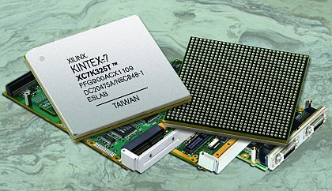
Outlines
Presentation Outlines
1
Standardization of lightweight Cryptography
4
5
6
Why Lightweight Cryptography?
Lightweight Cryptography Algorithms
Lightweight Cryptography and FPGA
Trade-off for Lightweight Cryptography Design.
7
3
Introduction
8
Lightweight PRINCE Algorithm
2
What is Lightweight Cryptography?
Notes:
This slide shows Presentation Outlines

Slide 3
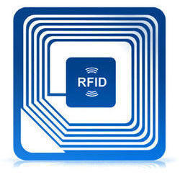
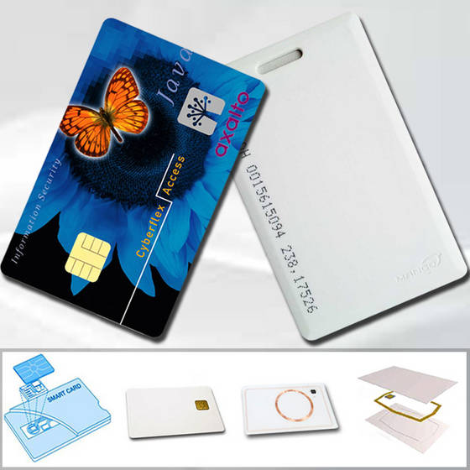
Introduction
Cryptography has been safeguarding emails, web browsers, cell phones and bank cards.
The deployment of small computing devices such as RFID tags, industrial controllers, sensor nodes and smart cards is becoming much more common.

Slide 4
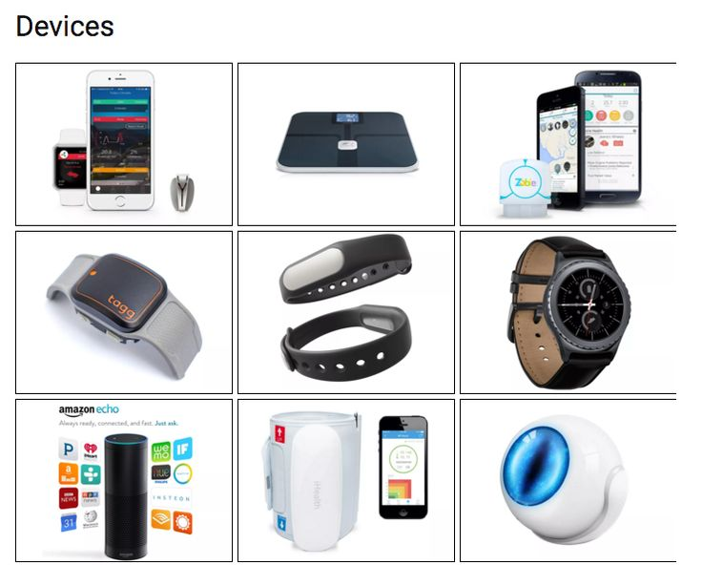
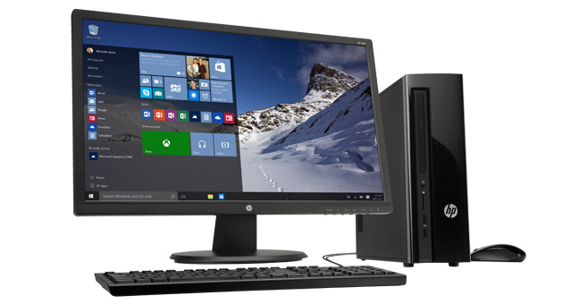
Introduction
The shift from desktop computers to small devices brings a wide range of new security and privacy concerns.
It is challenging to apply conventional standards to small devices.

Slide 5
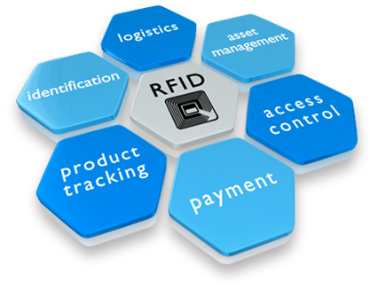
Why Lightweight Cryptography?
In many conventional cryptographic standards, the trade-off between security, performance and resource requirements was optimized for desktop and server environments, and this makes them difficult or impossible to implement in resource- constrained devices.
When they can be implemented, their performance may not be acceptable.

Slide 6
Lightweight Cryptography
Lightweight Cryptography is a relatively young scientific sub-field that is located at the intersection of electrical engineering, cryptography and computer science and focuses on new designs, adaptions or efficient implementations of cryptographic primitives and protocols.

Slide 7
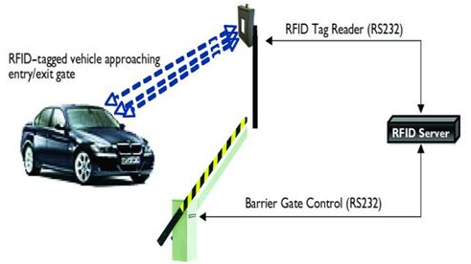
Lightweight Cryptography & NIST
In 2013, National Institute of Standards and Technology(NIST).
Study the performance.
NIST- Work to approve cryptographic standards on constrained devices to design a transparent process for standardization.
In 2015, NIST held the first Lightweight Cryptography Workshop in USA
Public feedback on the constraints and limitations of the target devices.
Requirements and characteristics of real-world applications of lightweight cryptography.

Slide 8
The standardization of lightweight Cryptography
Any design whether it’s a conventional one or unconventional novel structure is welcomed with keeping:
Cost
Power consumption
Cryptographic security
Performance
needed in today’s
world.

Slide 9
Lightweight Cryptography
Stream Ciphers
Block Cipher
Smaller internal State and Output size
Small Block Sizes (64, 80 rather than 128 bit)
Smaller Key sizes (less than 112)
Simpler rounds (4 or 8 Bit S-Box)
Simpler Key Schedules
Hash Function
Smaller message size
Message Authenticated Code (MAC)
Tag size least 64 Bits
Regular block cipher in counter mode
Simpler rounds

Slide 10
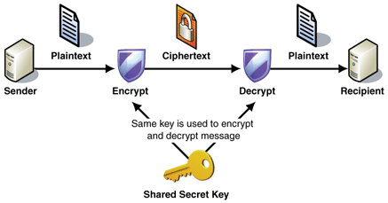
Lightweight Cryptography Algorithms
Stream ciphers :
2005 Grain
Block ciphers : 1977 DES, 1989 GOST 1997 XTEA 1998 AES 2005 mCrypton, STEA 2006 Hight, SEA 2007 Clefia, Kasumi DESL DESXL Present , DESL, DESXL, Present 2008 Puffin 2009 Katan, Ktantan, Hummingbird, MIBS 2010 PRINT 2011 Klein, LED, Twine, EPCBC, Vitamin-B, Piccolo
Hash functions : 2007 MAME 2008 Squash DM , DM-Present H , H-Present, Keccak 2010 Quark, Armadilo 2011 Spongent, Vitamin-H, Photon

Slide 11
Design Trade-off for Lightweight Cryptography
Every designer of lightweight cryptography has to cope with the trade-off between security, costs, and performance.

Slide 12
Performance Metrics Design
Area: Measured in µm2,area gate equivalents [GE].
Cycles: Number of clock cycles to computer result.
Time: The required amount of time for a certain operation as the operating frequency [ms].
Throughput: The number of output bits is divided by the time[bps].
Power: The power consumption [µW].
Energy: The energy consumption [µJ].
Current: The power consumption divided by the typical core voltage of the library.
Efficiency: The throughput to area ratio is used as a measure of hardware efficiency[bps GE].

Slide 13
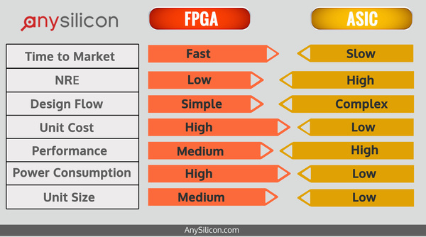
Lightweight Hardware Design
Lightweight block cipher commonly refers to algorithms with a very low implementation complexity, especially in hardware using ASICs or FPGA.
Advantage Vs. ASIC:
Short-time to Market
Low Cost
Reconfigurable
Advantage Vs. SW:
High Performance
Low Power
Low Cost

Slide 14
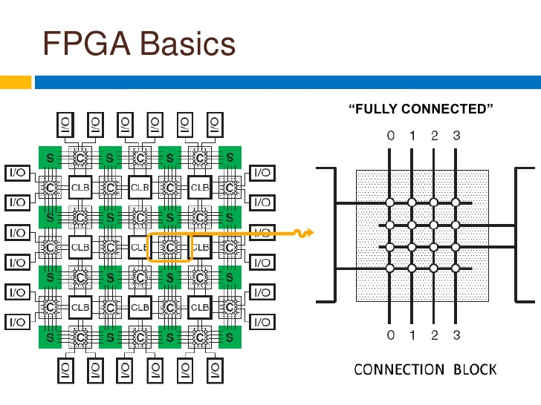
Field Programmable Gate Arrays. (FPGA)
The original FPGA devices were invented by XILINX Corporation in 1984.

Slide 15
FPGA Applications

Slide 16
Lightweight Block Cipher with FPGA
Lightweight Block Cipher with FPGA as platform
Substitution Permutation Networks (SPNs)
PRESENT
PRINCE
HIGHT
Piccolo
AES-128
Two Branched
AES-Like
LED
SPN-Based
SEA
TEA, XTEA
GFS
PRINTcipher
RC5
Khudra
Hummingbird
Feistel-Network (FN)
ICEBERG

Slide 17
Lightweight PRINCE Algorithm
PRINCE is a 64-bit SPN(substitution-permutation network) lightweight block cipher
128-bit key
12 rounds
Fixed key.
Sixteen 4×4 parallel S-boxes
linear diffusion

Slide 18
Hardware Architecture of PRINCE Algorithm with FPGA

Slide 19
PRINCE Internal Pipelining Architecture

Slide 20
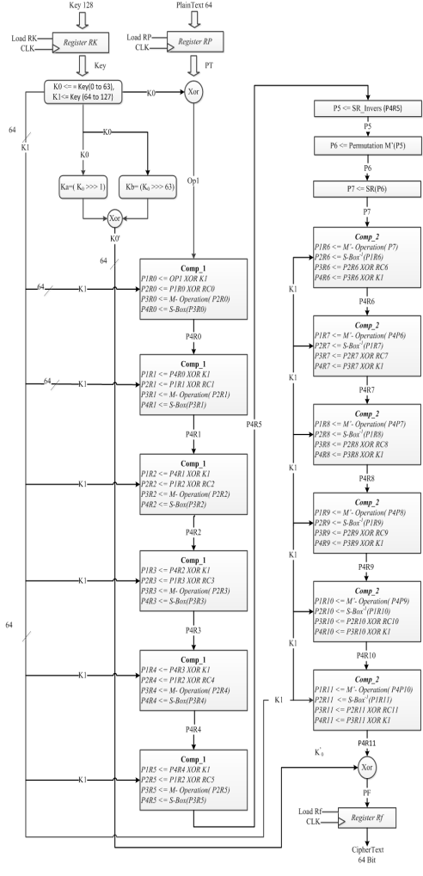
PRINCE Unroll Architecture

Slide 21
Share Resource Architecture Flowchart for PRINCE Algorithm

Slide 22
Simulation Analysis performed for both of the encryption and decryption

Slide 23
IP Core of PRINCE Algorithm

Slide 24
The Architectures of MicroBlaze with IP Core

Slide 25
Performance Comparisons of PRINCE, SEA, ICEBERG and AES FPGA Implementations
Algorithm | Block Size | Device | Clock Cycle | Max. Freq. (MHz) | Thro/put (Mbps) | Total Slices | Efficiency (Mbps/Slice)
PRINCE-128 | 64 | Virtex-4 4FF668 | 1 | 31 | 2032 | 956 | 2.126
AES [40] | 128 | Spartan-II XC2V40-6 | 32 | 123 | 358 | 1214 | 0.290
AES [42] | 128 | Spartan-II XC2S30-6 | 32 | 60 | 166 | 522 | 0.320
SEA-128 [14] | 128 | Virtex-II XC2V4000 | 32 | 145 | 156 | 424 | 0.368
ICEBERG [43] | 64 | Virtex-II | 32 | - | 1016 | 631 | 1.610

Slide 26
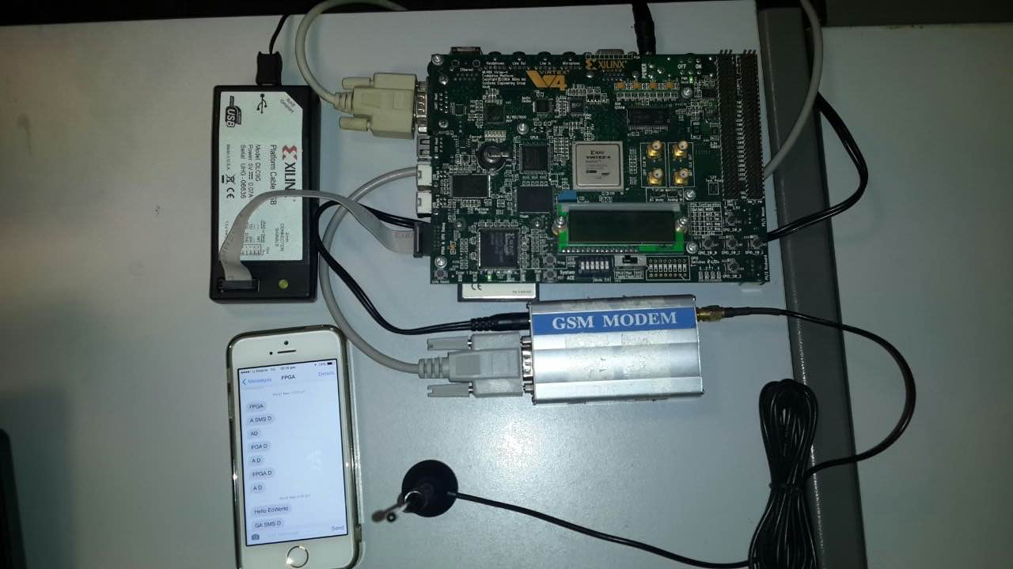
Virtex-403 FPGA Board with GSM and Mobile IPhone 6s

Slide 27
Thank You

